Slide 1

Software Design
Datamatiker /Computer Science
2nd Semester
Spring 2017
Software Design

Slide 2
Software Design
Agile context
Software design
System design
Object design
Software Design

Slide 3
Design Principles
Divide and conquer
High cohesion
Low coupling
High abstraction
Software Design

Slide 4
Design Principles: Divide and Conquer
Architecture (decompose system into layers)
Classes & methods
Why?
  Overview & Maintainability
    We need not deal with (all) high complexity at the same time
  Reusability
    e.g. replace UI layer, reuse date function
  Robustness
    Each module can be tested individually (layers and classes/methods)
Software Design

Slide 5
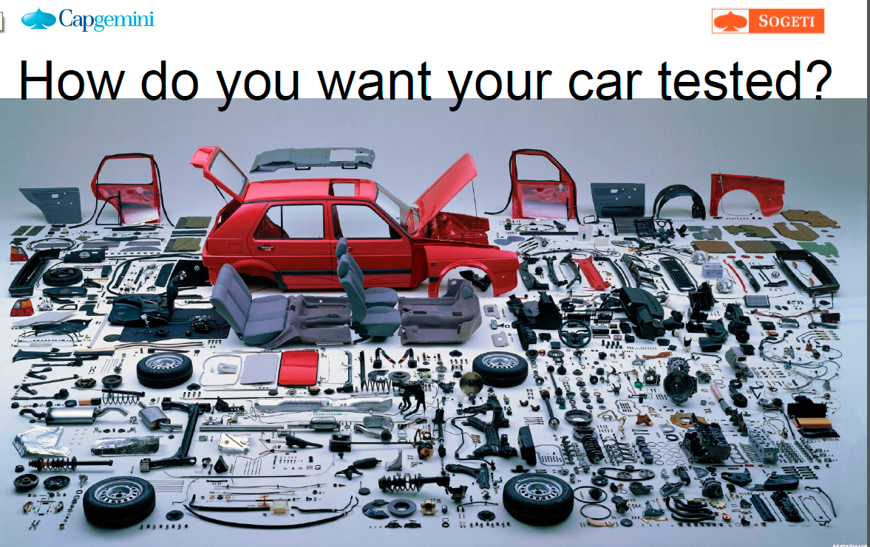

Divide and conquer example
Software Design

Slide 6
Design Principles: High Cohesion
Architecture (inside layers)
Class (attributes and methods)
Why?
    Reuse and testability (maintainability)
      Easier to understand and change a module if it keeps together things that are related to each other, and keeps out other things
Software Design

Slide 7
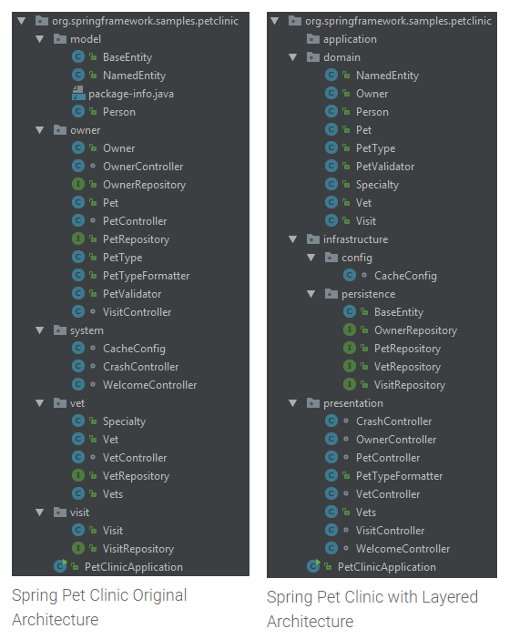
Layers example
2 different ways of layering the same app
The cohesion in the layers is seen from different perspectives in the 2 examples
Software Design

Slide 8
Design Principles: Low Coupling
Architecture (between layers)
Between classes inside a layer
Why?
  Reuse and testability (maintainability)
    When interdependencies exist, changes in one place will require changes somewhere else.
    A network of interdependencies makes it hard to see at a glance how some component works
Software Design

Slide 9
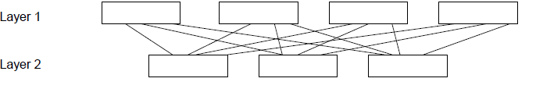
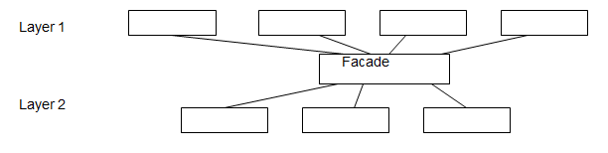
Low Coupling examples
High coupling:
Low coupling:
Facade pattern becomes the API of a layer
The Facade class itself ends up with low cohesion
Software Design

Slide 10
Demo
Let’s get low coupling between layers ☺
Software Design
Notes:
Use FrontController.java
Prep:
Remove DBFacade
Remove PartMapper constructor without connection
1. step
Add DataMapperTestable jar

Slide 11
Design Principles: Abstraction
Architecture (layers)
Classes & methods
Why?
  Provides information hiding
  Let you understand purpose of module without having to know details
Software Design

Slide 12
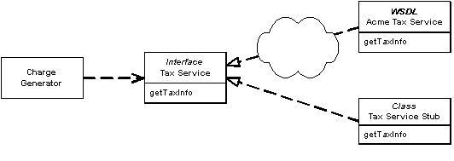
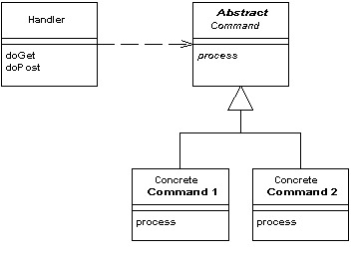
Abstraction examples
Super classes and interfaces increase level of abstraction
Abstract class ex: Interface ex:
Software Design

Slide 13
Exercises
Put Facade in the data access layer
Consider Facade and Controller(s) in model layer
Make sure you have MVC architecture in UI layer
Consider the Command pattern in the UI layer
Advanced
Run Source Code metrics for your project
Consider what interfaces and dependency injection can do for the quality of your project
Software Design

